Slide 1
3D Media – An Overview
By: Mathieu Spénard-Gingras

Slide 2
Outline
How 3D works – Perception
Generating 3D content
Displaying 3D content
3D Models
Transport
Structure of H.264/MVC Bitstreams
Remote Rendering
Energy-efficient streaming to Mobile Devices

Slide 3
Perception
Illusion of 3D!!
Purely biological
Send 2 “views”, and the brain gets “tricked” and see a scene as 3D

Slide 4
Perception (cont’d)
Cues
Shadows
Size
Position (item in front of another)
Head motion parallax

Slide 5
Generating 3D Videos
Multiview
Arrays of cameras, each pair filming a scene from a different perspective
Distance within each pair ~65mm, the average distance between 2 eyes
Needs to be perfectly synchronized
Colour-calibration
Artifacts can arise from the lack of synchronization, especially during scenes with a high level of actions

Slide 6
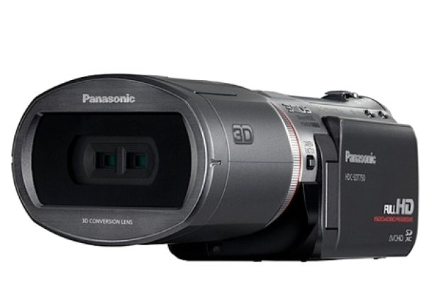
Generating 3D Videos
“Panasonic HDC-SDT750K,” http://www2.panasonic.com/consumer-electronics/shop/Cameras-Camcorders/Camcorders/model.HDC-SDT750K
available for USD999 @ Amazon.com

Slide 7
Generating 3D Videos
Depth-Map
Can film a scene in 2D, and construct a depth map using laser technologies
Depth maps are sensitive to various artifacts, especially when compressed, and the impact is non-negligeable
No left and right views – have to be generated

Slide 8
3D Video Families
Stereo Videos
Movie Theatres
3DTV
Free Viewpoint Videos
Virtual Reality
Navigation

Slide 9
Displaying 3D
Active glasses
Require power
3DTV at home
TV sends one left view frame, then a right view frame and so on. Glasses are synchronized with the TV, and the appropriate shutter is being activated.
Passive glasses
Movie theatre
Polarized linearly or circularly in order to separate the views

Slide 10
Autostereoscopic Displays
Glasses-free
Views
Given a user, can use head motion parallax (no movement) and still see something on the screen
Different for vertical head motion
Require more views when many users want to watch
Can receive data for some views, and estimate the others

Slide 11
Autostereoscopic Displays (cont’d)
Many autosteroscopic displays were shown at the Internationale Funkausstellung Berlin (IFA) 2010, a tradeshow
Lots of prototypes, very high price tags, and not ready for the market until 3-5 years
Samsung SCH-B710, a mobile device available in South Korea, has an autostereoscopic 3D display
Consumer Electronics Show 2011 in Las Vegas: not that much 3D with glasses as the industry understand customers do not like them

Slide 12
3D Models – Video Plus Depth
One 2D video, and a matching Depth Map
Not a lot of data: a regular video, and a depth map that can be visually represented by a greyscale
Prone to artifacts
Requires lots of power for rendering

Slide 13
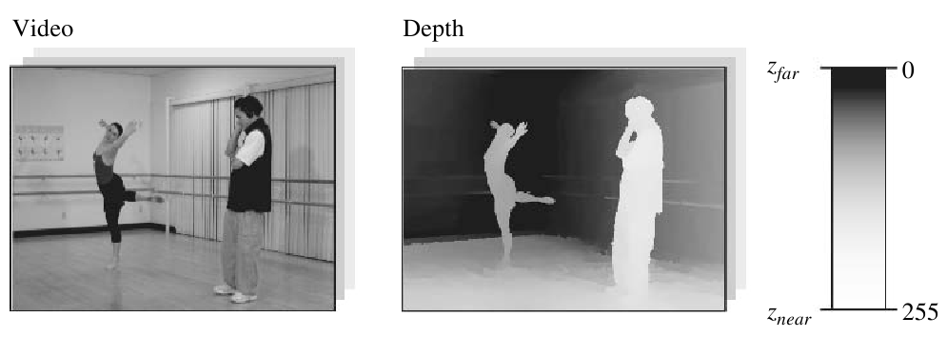
Video Plus Depth
H. M. Ozaktas and L. Onural, Eds., Three-Dimensional Television: Capture, Transmission, Display. Springer, 2008

Slide 14
3D Models – Multi-view Videos
Each view requires one left- and right-eye view. Lots of data
Can independently encode each view with H.264/AVC and H.264/SVC. No inter-view redundancy
Can encode with H.264/MVC (inter-view redundancy) and H.264/SMVC

Slide 15
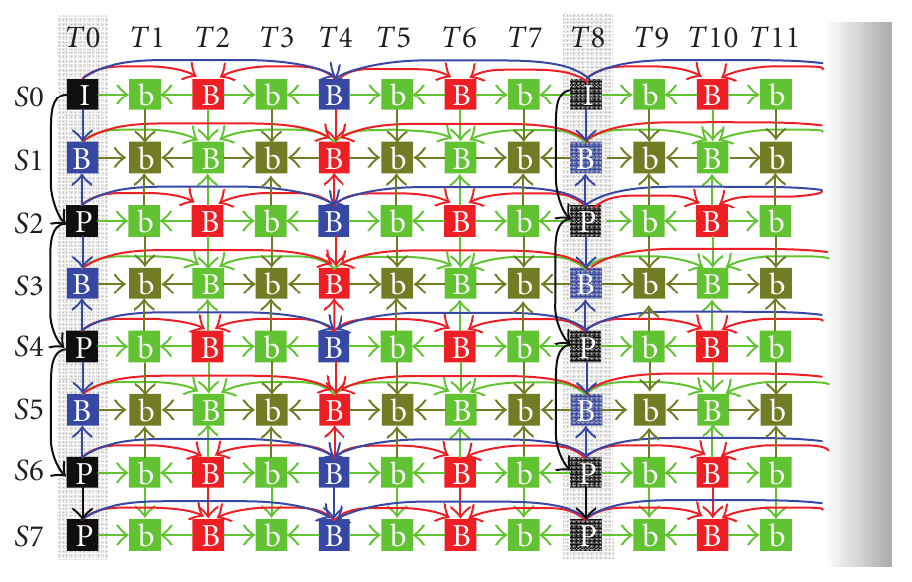
Multi-view Encoding
K. U. M. M. H. J. L. Ying Chen, Ye-Kui Wang and M. Gabbouj, “The emerging mvc standard for 3d video services,”
EURASIP Journal on Advances in Signal Processing, vol. 2009, 2009

Slide 16
H.264/MVC
Amendment of H.264/AVC
Backward compatible
Anchor frames, which helps supporting random access point (ex: fast forwarding)
View switching

Slide 17
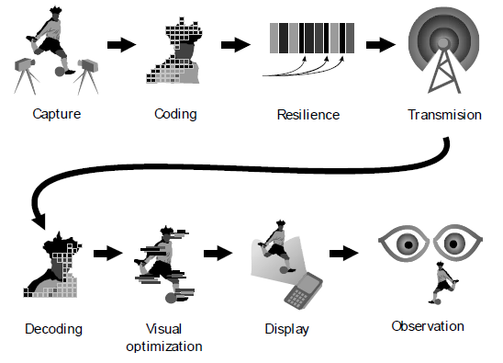
3DTV
A. Gotchev, S. Jumisko-Pyykk¨o, A. Boev, and D. Strohmeier, “Mobile 3DTV System: Quality and User Perspective,”
Proceedings of EUMOB, 2008

Slide 18
3DTV Data Transmission
Lots of data!
Mobile devices might require 1 view – autostereoscopic displays at home many
Requires significant more processing power than conventional TV
Requires significant more bandwidth due to more data needed to be transmitted

Slide 19
Transmission Modes
DVB-H in Europe; T-DMB in South Korea
Experiment was done with DVB-H and existing Forward Error Connection could be leveraged under some conditions [5]
DVB-H’s time slicing could also be leveraged [5]
Could also use:
WiFi
3G
3G+
4G

Slide 20
3DTV for Mobile Devices
“If to appeal to the users sooner, 3D has to be introduced through the ‘back doors’ of some more dynamic and novel technology receptive market niches, such as mobile devices”[1]
Very limited number of views
Limited screen real estate and resolution
Limited battery life/power processing
Limited bandwidth (available, on the move, and cost prohibitive)

Slide 21
How to make this work?
Reduce power consumption and/or reduce bandwidth
If compress a lot, a lot of power will be spend on decompressing and rendering
If does not compress a lot, a lot of power will be spent by the receiving circuits
Not known how those 2 important variables are connected to one another

Slide 22
Related Work
Users send in an XML request exactly what they want, in order to reduce extra data that is not needed [2]
Decrease the resolution of one of the view. Decrease the amount of data needed to transmit, without affecting quality [3]
Put as many computation as possible on the server, so the client does not have to do too much processing [4]

Slide 23
Remote Rendering
Proxy between server and client
Can do all, part or none of the decoding
Proxy can “filter” data, such as decreasing the resolution
Virtual reality environments:
cell phones can render point clouds, so the proxy converts meshes (expensive) into point-based model [6]
Finding the best reference frame processing done on the proxy with GPUs using CUDA [7]
Image streaming: Server render everything from 3D, and sends 2D to the client

Slide 24
Future Work
Energy-aware 3D Video Streaming and Adaptation
Adaptive streaming algorithm that takes into consideration the battery life and mobile device specific parameters, and gives a choice of quality vs watching time
Same spirit as [8]
Study the use of remote rendering for streaming 3D videos, using WiFi, 3G, 3G+, 4G, DVB-H, etc
Use MVC, but also SMVC

Slide 25
Future Work (cont’d)
Remote rendering:
Optimize the amount of bandwidth to use, and the amount of data to send raw, and decoded to the client
Relate to # views
Relate to frame rate
How much to decode?
Can involve using 2D instead of 3D in extreme cases
Must be fast and efficient as it needs to be run often to have an accurate picture of the situation

Slide 26
Conclusion
3D technologies leverage the brain perception of 3D to display 3D content using 2D
Technology is evolving fast, and “glasses-free” displays are on their way
3D videos can be represented with multi-view videos, and encoded using H.264/MVC, which uses the inter-view redundancy for a greater efficiency
Mobile 3DTV: study the use of remote rendering for optimizing power consumption, bandwidth and quality for end users

Slide 27
Questions?
Thank you!

Slide 28
References
[1] A. Gotchev, S. Jumisko-Pyykk¨o, A. Boev, and D. Strohmeier, “Mobile 3DTV System: Quality and User Perspective,” Proceedings of EUMOB, 2008.
[2] I. Park, M. Kim, H. K. Kim, and H. Byun. Interactive multi-view video adaptation for 3dtv. [Online]. Available: ieeexplore.ieee.org/iel5/4539739/4547776/04547815.pdf.
[3] A. Smolic, K. Mueller, P. Merkle, P. Kauff, and T. Wiegand, “An overview of available and emerging 3D video formats and depth enhanced stereo as efficient generic solution,” in Proceedings of the 27th conference on Picture Coding Symposium. Institute of Electrical and Electronics Engineers Inc., The, 2009, pp. 389–392.
[4] J. Kwon, M. Kim, and C. Choi, “Multiview Video Service Framework for 3D Mobile Devices,” in International Conference on Intelligent Information Hiding and Multimedia Signal Processing. IEEE, 2008, pp. 1231–1234.
[5] A. Gotchev, A. Smolic, S. Jumisko-Pyykk¨o, D. Strohmeier, G. Akar, P. Merkle, and N. Daskalov, “Mobile 3D television: Development of core technological elements and user-centered evaluation methods toward an optimized system,” in special session’Delivery of 3D Video to Mobile Devices’ at the conference’Multimedia on Mobile Devices’, a part of the Electronic Imaging Symposium, 2009.
[6] S. Shi, M. Kamali, K. Nahrstedt, J. C. Hart, and R. H. Campbell. A high-quality low-delay remote rendering system for 3D video. In Proceedings of the international conference on Multimedia, pages 601–610, Firenze, Italy, October 2010. ACM.
[7] W. Yoo. Shi Shu, W. J. Jeon, K. Nahrstedt, and R. H. Campbell. Real-time parallel remote rendering for mobile devices using graphics processing units. In Multimedia and Expo (ICME), 2010 IEEE International Conference on, pages 902–907, Suntec City, Singapore, July 2010. IEEE.
[8] C. H. Hsu and M. Hefeeda. Achieving viewing time scalability in mobile video streaming using scalable video coding. In Proceedings of the first annual ACM SIGMM conference on Multimedia systems, pages 111–122, Phoenix, AZ, February 2010. ACM.

