Slide 1

Time Slicing in Mobile TV Broadcast Networks with Arbitrary Channel Bit Rates
Cheng-Hsin Hsu
Joint work with Dr. Mohamed Hefeeda
Simon Fraser University, Canada
April 23, 2009

Slide 2
Outline
Motivation
Problem
  Saving energy on mobile devices in mobile TV networks
Solution and Analysis
  Efficient approximation algorithm
Evaluation
  With simulations and a real testbed
Conclusion

Slide 3
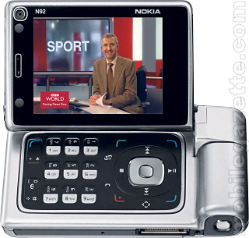
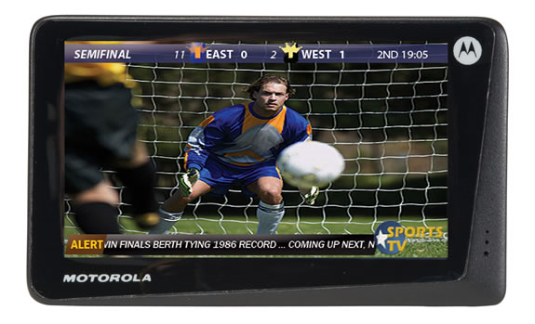
Mobile TV
Watch TV anywhere, and anytime
Watch more programs → higher revenues for service providers
Broadcast over cellular networks
  but they are: (i) designed for unicast, and (ii) narrowband

Slide 4
Mobile TV Broadcast Networks
T-DMB: Terrestrial Digital Media Broadcasting
  Started in South Korea
  Limited bandwidth (< 1.8 Mbps)
DVB-H: Digital Video Broadcast – Handheld
  Extends DVB-T to support mobile devices
  High bandwidth (< 25 Mbps), energy saving, error protection, efficient handoff, ….
  Open standard
MediaFLO: Media Forward Link Only
  Similar to DVB-H, but proprietary (QualComm)

Slide 5
Mobile TV Receivers
In contrast to TV sets
  Battery powered
  Mobile and wireless
  Small displays
Energy consumption is critical on mobile devices
  Mobile TV chip consumes 40~60% energy ← our measurements on Nokia N96 phones
  Broadcast standards dictate mechanisms to save energy

Slide 6
Outline
Motivation
Problem
  Saving energy on mobile devices in mobile TV networks
Solution and Analysis
  Efficient approximation algorithm
Evaluation
  With simulations and a real testbed
Conclusion

Slide 7
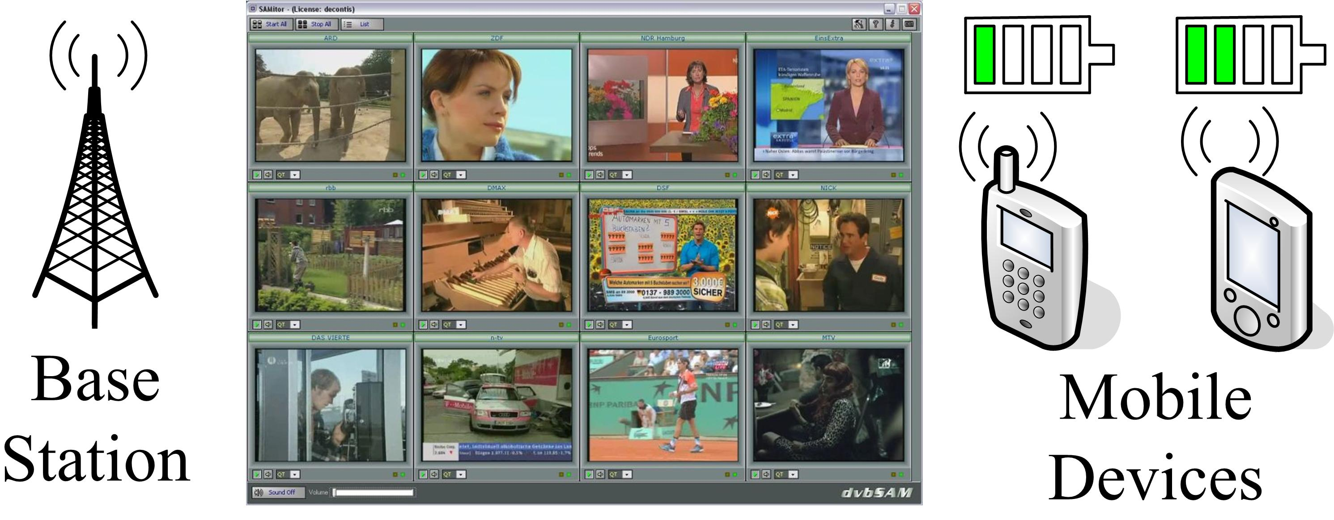
Problem Statement
  Optimally broadcast multiple TV channels to minimize energy consumption on mobile devices

Slide 8
Energy Saving for Mobile Devices
Bit Rate
Burst
Overhead T_{o}
R
Off
r
Time
This is called Time Slicing (in DVB-H and MediaFLO)
Need to construct Feasible Time Slicing Schedules
  No receiver buffer under/over flow instances
  No overlap between bursts
Burst scheduling problem for base stations
Notes:
8

Slide 9
Burst Schedule
Bit Rate
R
Window p
Time
Easy IF all TV channels have same bit rate
  Currently assumed in many deployed networks
    Simple, but is it efficient (visual quality & bw utilization)?
    TV channels broadcast different programs (sports, series, talk shows, …) ➔ different visual/motion complexity

Slide 10
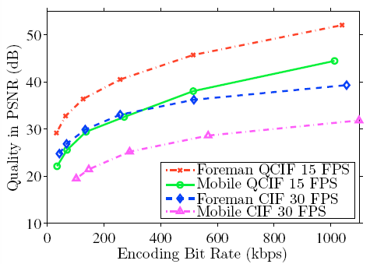
The Need for Different Bit Rates
Encode multiple video sequences using H.264/AVC codec at various bit rates, measure quality
10 dB
Wide variations in quality (PSNR), as high as 10—20 dB

Slide 11
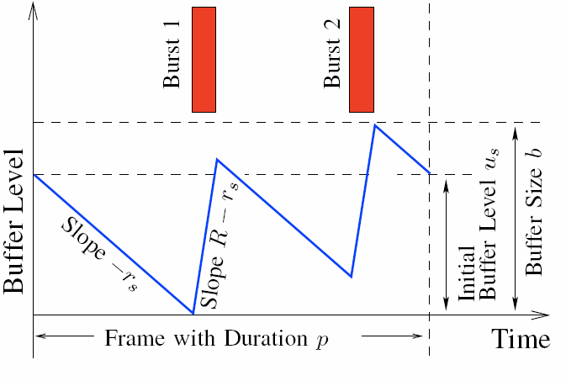
Burst Scheduling with Different Bit Rates
Bit Rate
R
Time
Window p
Ensure no buffer violations for ALL TV channels
Difficult Problem
Notes:
11

Slide 12
Challenge
  Shifting bursts in time can lead to playout glitches
Buffer Fullness
Buffer Fullness
Buffer Fullness
Time
Time
Time
Buffer Underflow
Buffer Overflow
Notes:
12

Slide 13
Harness
Theorem: Burst Scheduling to minimize energy consumption for TV channels with arbitrary bit rates is NP-Complete
Proof Sketch:
  We show that minimizing energy consumption is the same as minimizing number of bursts
  Then, we reduce the task sequencing problem with release times and deadlines problem to it
We can NOT optimally solve it in Real Time
Notes:
13

Slide 14
Outline
Motivation
Problem
  Saving energy on mobile devices in mobile TV networks
Solution and Analysis
  Efficient approximation algorithm
Evaluation
  With simulations and a real testbed
Conclusion

Slide 15
Solution Approach
Observation: Hardness is due to tightly-coupled constraints: no burst collision & no buffer violation
  could not use previous machine scheduling solutions, because they will produce buffer violations
Our idea: decouple them!
  Transform problem to a buffer violation-free problem
  Solve the transformed problem efficiently
  Convert the solution back to the original problem
  Ensure correctness and bound optimality gap in all steps
Notes:
15

Slide 16
Double Buffering Scheduling (DBS)
Transform idea:
  Divide receiver buffer into two: B and B’
  Drain B while filling B’ and vice versa
  Divide each scheduling frame p into multiple subframes
  Schedule bursts s.t. bits received in a preceding frame = bits consumed in current frame
Drain
Fill
Buf B
Fill
Fullness
Buf B’
Drain
Fill
Drain
Notes:
16

Slide 17
DBS Algorithm: Pseudocode
// double buffering transform
For each TV channel, divide the scheduling frame into multiple subframes based on its encoding bit rate
// note that each frame is specified by <start_time, target_burst_length, end_time>
// burst scheduling based on decision points
For each decision point t, schedule a burst from time t to t_{n} for the subframe with the smallest end_time, where t_{n} is the next decision point

Slide 18
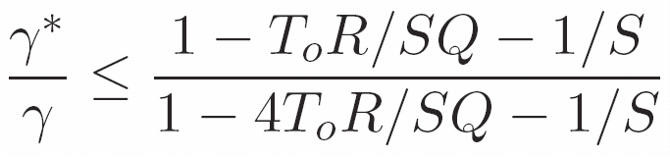
Correctness and Performance
Theorem: Any feasible schedule for the transformed problem is a valid schedule for the original problem.
  Also a schedule will be found iff one exists.
Theorem: The approximation factor is:
How good is this?
Notes:
18

Slide 19
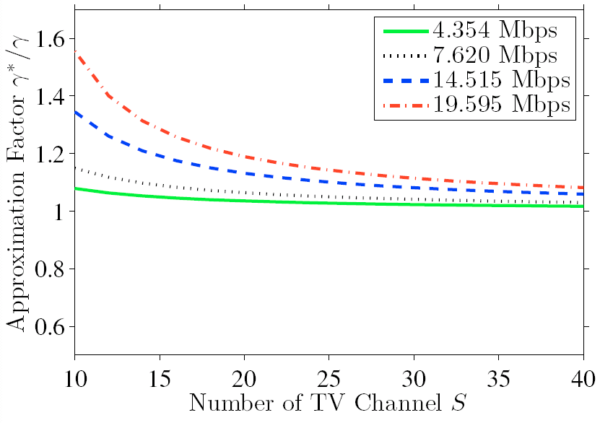
Approximation Factor
20 channels (R = 7.62 Mbps), energy saving achieved by the algorithm is 5% less than the optimal
Notes:
19

Slide 20
Outline
Motivation
Problem
  Saving energy on mobile devices in mobile TV networks
Solution and Analysis
  Efficient approximation algorithm
Evaluation
  With simulations and a real testbed
Conclusion

Slide 21
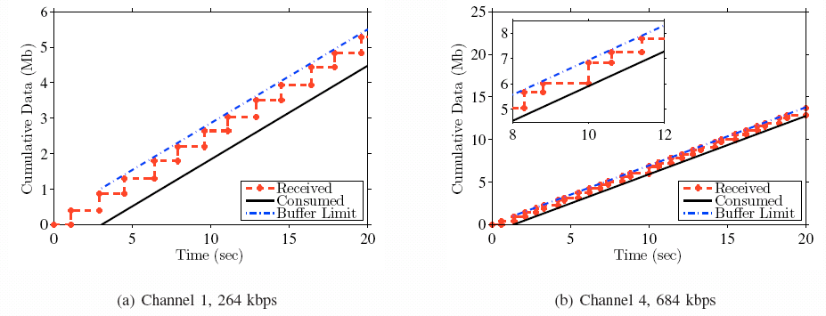
Empirical Evaluation
Broadcast 12 TV channels
No buffer violations
Notice the buffer dynamics are different
Notes:
21

Slide 22
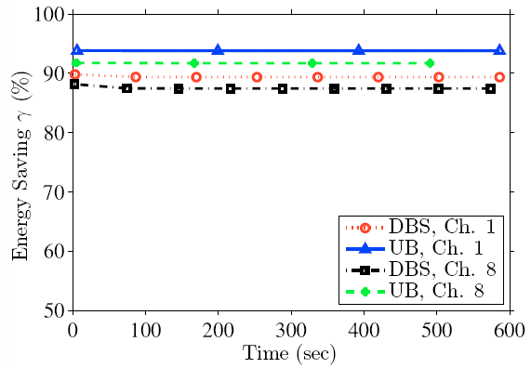
Near-Optimality in Energy Saving
Compare against a conservative upper bound
  Broadcast channels one by one
Gap < 7%
Notes:
22

Slide 23
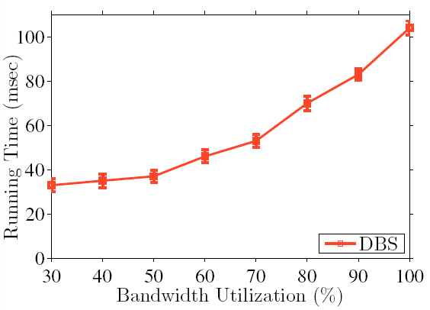
Efficiency
Running time for a 10-sec window is < 100 msec on commodity PC for broadcasting channels saturating the air medium
Notes:
23

Slide 24
Outline
Motivation
Problem
  Saving energy on mobile devices in mobile TV networks
Solution and Analysis
  Efficient approximation algorithm
Evaluation
  With simulations and a real testbed
Conclusion

Slide 25
Conclusion
Broadcast multiple TV channels to minimize energy consumption on mobile devices
A near-optimal algorithm for a NP-Complete burst scheduling problem
Approximation factor close to 1 for typical network parameters
Evaluated with simulations and a real mobile TV testbed
Notes:
25

Slide 26
Questions?
Thank you!
More details can be found online at
  http://nsl.cs.sfu.ca

