Slide 1
Scalable Video Transmission for MobileTV
Farid Molazem
Network Systems Lab
Simon Fraser University

Slide 2
Problem Statement
Broadcasting a number of scalable video streams from a base station to a large number of mobile receivers
Bandwidth utilization
Energy saving
Quality of the transmitted video
We describe:
Scalable Video Coding basics
Formulation for our problem
Results

Slide 3
Scalable Video Coding
Scalable video coding
Temporal scalability
Spatial scalability
Quality scalability
Temporal scalability
Altering temporal resolution of a video
Dropping random frames does not work
Other frames might depend on them for motion compensation
The frames must be encoded in hierarchical prediction structure

Slide 4
GOP
GOP
Four Temporal Layers
0
4
3
5
2
7
6
8
1
12
11
13
10
15
14
16
9
Non-Delay
Motion Prediction
0
1
2
3
4
5
6
7
8
9
10
11
12
13
14
15
16
Non-Dyadic
Temporal Layers
0
1
2
3
4
5
6
7
8
9
10
11
12
13
14
15
16

Slide 5
Spatial Scalability
Images with different spatial resolutions
Each layer in the spatial scalable video stream improves the final image resolution

Slide 6
Spatial Scalability
Inter-layer motion prediction
Inter-layer residual prediction
Inter-layer intra prediction

Slide 7
Quality Scalability
Quality scalability could be considered as a special case of spatial scalability
Dividing the video into several quality layers: Coarse Grain Scalability (CGS)
In CGS, motion estimation is conducted in each spatial layer separately
Switching between frames is only possible at I-frames
The choice among different bitrates is limited to the number of layers

Slide 8
Coarse Grain Scalability

Slide 9
Quality Scalability
Alternatives for CGS:
All quality levels in one spatial layer
Fine Grain Scalability
Motion compensation is done at the lowest quality level of the reference picture

Slide 10
Quality Scalability
FGS advantages:
Encoder and decoder use the same quality level of the reference picture
Bitrate scaling could be done at packet level
FGS disadvantage:
Coding efficiency

Slide 11
Quality Scalability
To improve motion prediction we can use the highest quality layer
The problem with this method is that it could cause drift
Drift

Slide 12
Quality Scalability
Medium Grain Scalability
A trade-off between Fine Grain Scalability and Coarse Grain Scalability
Keeps drift at an acceptable level
Motion prediction done in the enhancement layer with periodic updates at base layer

Slide 13
Problem Formulation
Problem: Broadcasting S scalable video streams from a base station to a large number of mobile receivers over a wireless medium
Notation:
There are S video streams
Each frame video stream s has a base layer and MGS layers
Each video stream has I frames
Indicates the size of layer k of
frame i of stream s
Each stream is coded at F frame-per-second
Base layer
Frame i of stream s

Slide 14
Problem Formulation
Energy Saving:
The fraction of time the receivers can put their wireless receivers into sleep
We use the average energy saving among all video streams
The average quality of all transmitted frames is shown by
We use peak-signal-to-noise-ration (PSNR) as a quality metric

Slide 15
Problem Formulation
Bandwidth Utilization
Energy Saving
Average Image Quality

Slide 16
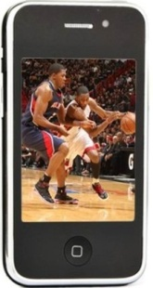
Problem Solution
Size B
Size B/2
Size B/2
buffer
buffer
buffer
Data
Buffer being
filled
Buffer being
drained
Image from
http://www.supgifts.com/images/cell%20phones/Cellphone652.jpg

Slide 17
Problem Solution
Time window in which one
buffer is being drained and
another one being filled
The length of time window should be equal to the playout time of the playing buffer
Stream s
The amount of data assigned to stream s in each time window should be the size of half a buffer

Slide 18
Problem Solution
The usefulness of a frame
s
s+1
s+2
Rescheduling window

Slide 19
Adaptive windows
There is a trade-off between energy saving and bandwidth utilization
We can constantly send small bursts of data for receivers, but the receiver circuits should be active all the time
Current time
Playout deadline of receivers

Slide 20
Adaptive windows
Missed frames
New deadline

Slide 21
Adaptive windows
Having a dynamic candidate set of streams
Stream s becomes a candidate if α * B of the buffer size (B) gets drained
Only schedule data for the streams in the candidate set
If α is low, we tend to schedule data for the receivers early and when there is lower buffer space. This results in smaller bursts
If α is higher, there will be more space in the receiver buffer and this could result into scheduling bigger bursts
Notes:
hello

Slide 22
Adaptive windows
Important parameters
The buffer level
is the number of frames sent for stream s
The deadline
The candidacy time

Slide 23
Adaptive windows
At time t, we schedule a burst for a candidate stream s until either:
Receiver buffer for stream s is full
Time where is the stream with the closest candidacy time among all non-candidate streams
Maximum burst size M
After scheduling a burst, whenever there is a missed deadline:
We go back to time for which the decoding deadline of frames is not passed and set α= α/2
We increase α after time t for each burst until it reaches to its initial value

Slide 24
Video stream preparation
ffmpeg to convert mp4 files to yuv files
Joint Scalable Video Model (JSVM), the reference software for H.264/SVC
BitstreamExtractorStatic
To extract MGS layer information
To create video streams with different quality layers
PSNRStatic
To extract PSNR value for each MGS layer of each frame

Slide 25
Results

Slide 26
Results

Slide 27
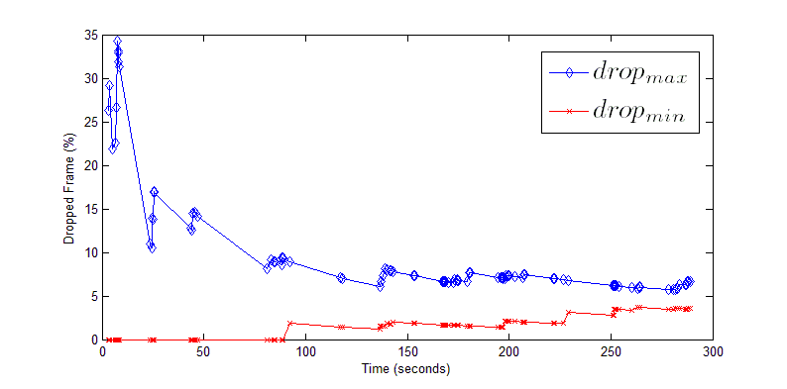
Results

Slide 28
Results

Slide 29
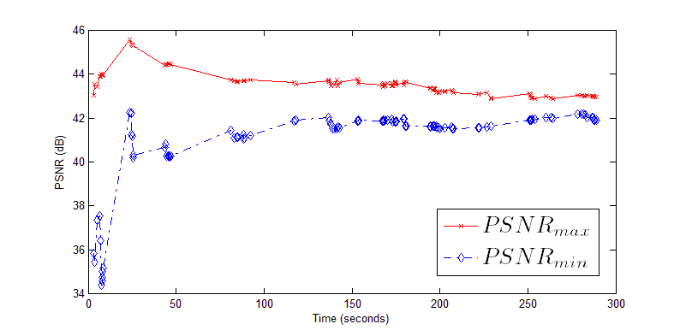
Results

Slide 30
Future Works
Analysis of the energy saving and bandwidth utilization based on adaptive parameter
Finding lower/higher bound for energy saving and bandwidth utilization based on adaptive parameter
Finding the updating formulation for the adaptive parameter that leads to the best results for energy consumption and bandwidth utilization

Slide 31
Thanks You

