Slide 1
Technical Report
Multimedia Streaming Over
WiMax Networks

Slide 2
Multimedia Streaming Over
WiMax Networks
Introduction
Protocol Layering
Multimedia Features
Quality of Service (QoS)
Existing Works
Enhanced MBS
Conclusion

Slide 3
Introduction
WiMax
  Worldwide Interoperability for Microwave Access
IEEE 802.16 standards
  IEEE 802.16d - 2004
  IEEE 802.16e - 2005
  IEEE 802.16m - TBA
Last Mile Broadband Access
  Wireless alternative to cable and DSL
Deployment
  Sprint 4G network
  Clearwire ISP

Slide 4
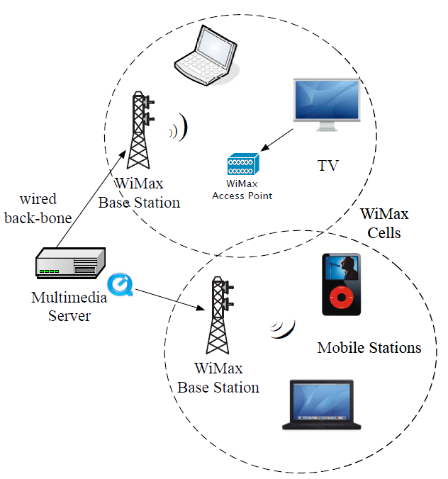
Introduction
Multimedia Streaming
  Content are encapsulated as IP packets
Mesh Network
  Signal can take multiple paths
Base Stations
  Like cellular towers
  In theory 50 km coverage, but in practice 10 km
  Femto, pico, micro and macro

Slide 5
Introduction
Subscriber Stations
  Client devices
  Built-in laptop or multimedia devices
  Standalone access point
Mobile Stations
  Mobile version of SS
  Battery powered, power saving is important

Slide 6
Multimedia Streaming Over
WiMax Networks
Introduction
Protocol Layering
Multimedia Features
Quality of Service (QoS)
Existing Works
Enhanced MBS
Conclusion

Slide 7
Protocol Layers
Two Layers
  MAC and PHY layers
  Integrates into OSI Data Link and Physical layers
Media Access Control (MAC) Layer
  Interfaces with upper layer protocols
  Allows Wimax to be build on top of multimedia applications.
  Provides
    Packets fragmentation
    Security
    Quality of Service (QoS)

Slide 8
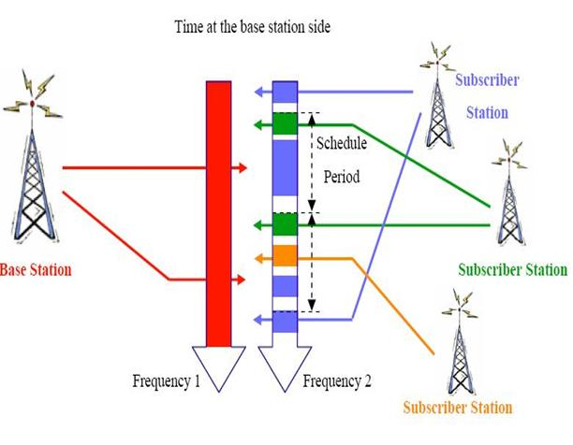
Protocol Layers
Physical (PHY) Layer
  Supports two types of connections
  Frequency Division Duplexing(FDD)
  and Time Division Duplexing(TDD)

Slide 9
Multimedia Streaming Over
WiMax Networks
Introduction
Protocol Layering
Multimedia Features
Quality of Service (QoS)
Existing Works
Enhanced MBS
Conclusion

Slide 10
Multimedia Features
Multicast Broadcast Service (MBS)
  Provides multimedia broadcast services
  Dedicated MBS frame or piggyback with unicast
  Supports macro diversity and mobility
  Mechanisms for delivery during sleep-mode
Forward Error Correction (FEC)
  Convolutional codes is required
  Encoding is apply at the PHY layer

Slide 11
Multimedia Features
Power Saving
  Support for sleep mode is mandatory in BS
  Optional on receiver
3 Power saving classes
  Type 1: fixed length, each sleep window is twice the last
  Type 2: equal sleep and listen windows
  Type 3: single sleep and listen windows, the BS controls the start and end time. Recommended for multicast services.
Notes:
Type 1 is used in Best Effort
Type 2 is used in Unsolicitated Grants
Type 3 multicast

Slide 12
Multimedia Streaming Over
WiMax Networks
Introduction
Protocol Layering
Multimedia Features
Quality of Service (QoS)
Existing Works
Enhanced MBS
Conclusion

Slide 13
Quality of Service (QoS)
Service Flows (SF)
  Defines by the MAC layer
  Maps QoS to each connection
  Packets scheduling not defined by standard
5 QoS Classes
  Each connection is assigned to a class
  Assign by the BS
  Request by the clients / subscriber stations
  Can be on-demand
Details of each class in Tech Report

Slide 14
Quality of Service (QoS)
Voice over IP (VoIP)
  Request for Unsolicited Grant Service (UGS)
  Explicit bandwidth grant, BS grants bandwidth as needed
Streaming Video
  Real-Time Polling Service (rtPS)
  BS provides unicast poll, the SS can request for additional bandwidth
  Requires more overhead than UGS

Slide 15
Quality of Service (QoS)
Bandwidth Requests
  Initiates by the SS
  In Broadcast service it affects all SS
  Can be on a per connection basis
  Piggyback with another packet
Bandwidth Grants
  Grants are given out on a per connection or per subscriber station
  Grants per subscriber requires a scheduler at the SS

Slide 16
Multimedia Streaming Over
WiMax Networks
Introduction
Protocol Layering
Multimedia Features
Quality of Service (QoS)
Existing Works
Enhanced MBS
Conclusion

Slide 17
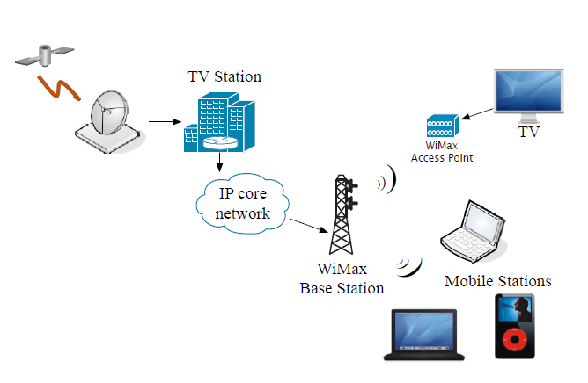
Existing Works
IPTV over WiMax
  WiMax as last mile
  TV channels are encapsulated
  No mentioning of ESG
WiMax as extension to DVB-H
  Complement coverage for DVB-H
  Provides services where satellite coverage is not possible (indoor).
  End users equip with WiMax receiver instead of DVB-H

Slide 18
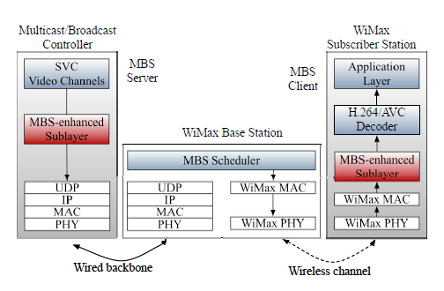
Existing Works
Video Delivery
  Proposed new sublayer
  Uses MBS framework
  Channels are mapped to
  connections
SVC Streaming
  Leverage multiple connections feature
  Uses Report Periods to request target bit rates
  Additional connections to improve reliability

Slide 19
Existing Works
SVC Streaming with MIMO
  Uses multiple-input and multiple-output (MIMO) technique
  Separate video bitstream into important (I-frames) and opportunistic bits (B and P-frames)
  I-frames are given higher code gain
  Results in better peak signal-to-noise ratio (PSNR)

Slide 20
Multimedia Streaming Over
WiMax Networks
Introduction
Protocol Layering
Multimedia Features
Quality of Service (QoS)
Existing Works
Enhanced MBS
Conclusion

Slide 21
E-MBS
Enhanced Multicast Broadcast Service (E-MBS)
  IEEE 802.16m draft
Support for switching between broadcast and unicast services
  Connections can switch between broadcast and unicast mode
Strict Requirements for Interruption Times
  1 to 1.5 seconds

Slide 22
Conclusion
WiMax is an ideal medium for multimedia streaming
Standard features
  Multicast Broadcast Service (MBS)
  Quality of Service (QoS)
  Real-time bandwidth grants
Enhanced version of MBS (E-MBS)
  Improves multimedia streaming over WiMax

Slide 23
References
[1] R. Hamzaoui, V. Stankovic, and Z. Xiong, Multimedia Over IP AND Wireless Networks: Compression, Networking, and Systems, 1st ed. AP, 2007.
[2] J. Andrews, A. Ghosh, and R. Muhamed, Fundamentals of WiMAX: Understanding Broadband Wireless Networking, 1st ed. Prentice Hall, 2008.
[3] A. Sayenko, V. Tykhomyrov, H. Martikainen, and O. Alanen, “Performance analysis of the ieee 802.16 arq mechanism,” in MSWiM ’07: Proceedings of the 10th ACM Symposium on Modeling, analysis, and simulation of wireless and mobile systems, Chania, Crete Island, Greece, 2007, pp. 314 322.
[4] F. Ohrtman, WiMAX Handbook: Building 802.16 Wireless Networks., 1st ed. McGraw-Hill, 2005.
[5] I. Uilecan, C. Zhou, and G. Atkin, “Framework for delivering iptv services over wimax wireless networks,” in Proc.

Slide 24
References
[6] G. Gur, S. Bayhan, F. Alagoz, and A. Jamalipour, “Framework for delivering iptv services over wimax wireless networks,” in Proc. IEEE International Workshop on Satellite and Space Communications, 2008 (IWSSC ’08), Legans, Madrid, Spain, October 2008, pp. 326–330.
[7] J. Wang, M. Venkatachalam, and Y. Fang, “System architecture and cross-layer optimization of video broadcast over wimax,” Selected Areas in Communications, IEEE Journal on, vol. 25, no. 4, pp. 712–721, May 2007.
[8] H. Juan, H. Huang, C. Y. Huang, and T. Chiang, “Cross-layer system designs for scalable video streaming over mobile wimax,” in Proc. WCNC 2007, Hong Kong, China, March 2007, pp. 1862 – 1866.
[9] J. Chui and A. Calderbank, “Multilevel diversity-embedded space-time codes for video broadcasting over wimax,” in Proc. International Symposium on Information Theory, 2008 (ISIT ’08), Toronto, Canada, July 2008, pp. 1068–1072.
[10] C. Cicconetti, L. Lenzini, E. Mingozzi, and C. Eklund, “Quality of service support in ieee 802.16 networks,” IEEE Network, vol. 20, no. 2, pp. 50–55, March/April 2006.

