Slide 1
Broadcasting Variable-Bit-Rate Videos in 802.16e-Like Mobile Networks

Slide 2
Outline
System Overview
Related Work
  [CKR08] “On the Trade-off between Energy and Multicast Efficiency in 802.16e-like Mobile Networks”, TMC08’
Weakness of [CKR08] for video broadcasting
How broadcasting videos in WiMAX different from doing that in DVB-H networks
Conclusion

Slide 3
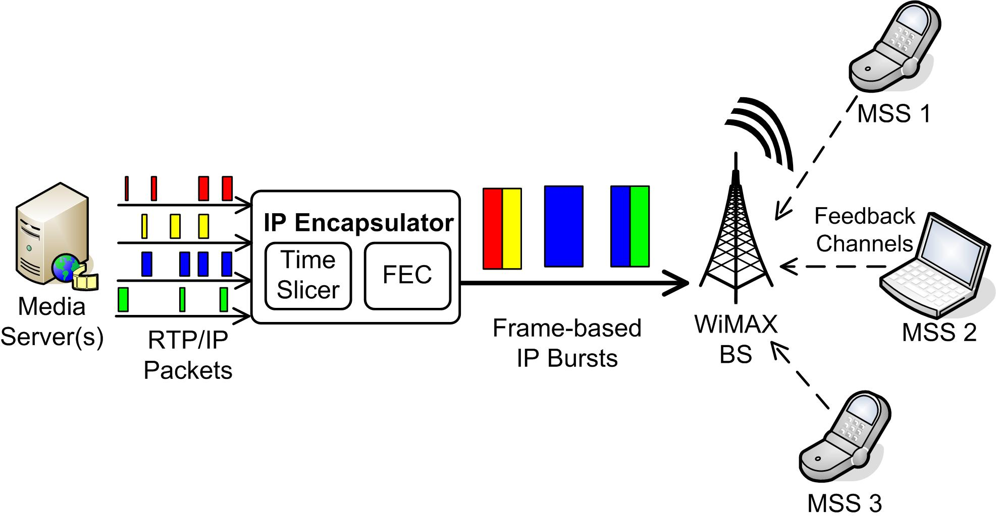
System Overview

Slide 4
Problem Statement
Consider a set of S VBR coded streams, and R mobile receivers, where receivers may watch different videos, under diverse channel conditions, and have various amounts of receiver buffer. Construct the a burst schedule for 802.16e-like networks to maximize the overall video quality.

Slide 5
Outline
System Overview
Related Work
  [CKR08] “On the Trade-off between Energy and Multicast Efficiency in 802.16e-like Mobile Networks”, TMC08’
Weakness of [CKR08] for video broadcasting
How broadcasting videos in WiMAX different from doing that in DVB-H networks
Conclusion

Slide 6
802.16e Frame Structure (FDD)
Multicast Superframe
Frame 1
Frame 2
Frame N
……
Time
Preamble
Broadcast Region
Unicast Slots

Slide 7
802.16e Frame Structure (TDD)
Multicast Superframe
Frame 1
Frame 2
Frame 3
Frame 4
Frame 5
Frame 6
Downlink
Time
Uplink

Slide 8
Broadcast Channels
Channel 1
Channel 2
Frame 1
Frame 2
Frame 3
Frame 4
Frame 5
Frame 6
Frame 7
Frame 8
Time
Ch. 1
Ch. 2
Ch. 3
Ch. 4
Frame 1
Frame 2
Frame 3
Frame 4
Frame 5
Frame 6
Frame 7
Frame 8
Time
Number of Channel in each superframe is
a system parameter

Slide 9
The Problem Solved in [TMC08]
Two outputs:
  Assigns items (fixed or variable size) to each broadcast channel
  (Optionally) Determine which MSS receive which broadcast channel
Objective:
  maximize the profit , where
  is the profit if MSS h happens to receive ch. i
  is 1 if h receives ch. i, and 0 otherwise

Slide 10
The Problem Solved in [TMC08] (cont.)
Three Problems
  SMBC-S: Assume each MSS is statically assigned to a channel, and assign the items to channels
  SMBC-D: Assume each MSS can be assigned to different channels in different superframe, also determine how to assign MSSes to channels
  SMBC-AMC: Assume the BS knows the channel conditions of all MSSes, and (statically) divide MSSes into two groups: 16QAM and QPSK.

Slide 11
How They Solved the Problems?
All these problems are identical to some forms of knapsack problems
  Greedy heuristics
  Dynamic programming
Evaluated by simulations

Slide 12
Outline
System Overview
Related Work
  [CKR08] “On the Trade-off between Energy and Multicast Efficiency in 802.16e-like Mobile Networks”, TMC08’
Weakness of [CKR08] for video broadcasting
How broadcasting videos in WiMAX different from doing that in DVB-H networks
Conclusion

Slide 13
Weakness of [TMC08]
Profit function is too abstract, and can model items with deadline, nor does it consider MSSes with limited buffer
  Not readily useable for video broadcasting, not mention VBR streaming
They use some assumed probabilistic functions to model user behavior (which channels they would watch)
  Why not capitalize the reverse links

Slide 14
Weakness of [TMC08] (cont.)
Use explicit control messages to assign MSSes to channels
  Better to use delta-T method for lower overhead
Corse-grained schedules, when number of channels is small, several video streams must be broadcast in the same channel
  Broadcast channel is the minimum receiving unit
Did not consider unicast traffic

Slide 15
Outline
System Overview
Related Work
  [CKR08] “On the Trade-off between Energy and Multicast Efficiency in 802.16e-like Mobile Networks”, TMC08’
Weakness of [CKR08] for video broadcasting
How broadcasting videos in WiMAX different from doing that in DVB-H networks
Conclusion

Slide 16
Differences from DVB-H
Reverse channels
  Reports watched channel for more accurate utility
  Reports channel condition for FEC/channel coding/modulation scheme adaptations
  Reports pattern of unicast traffic
Frame structure
  Need to consider frame boundaries, especially when under TDD

Slide 17
Differences from DVB-H (cont.)
Possibility of FEC/channel coding/modulation scheme adaptations
  Not explored in DVB-H yet due to lack of reverse channel

Slide 18
Outline
System Overview
Related Work
  [CKR08] “On the Trade-off between Energy and Multicast Efficiency in 802.16e-like Mobile Networks”, TMC08’
Weakness of [CKR08] for video broadcasting
How broadcasting videos in WiMAX different from doing that in DVB-H networks
Conclusion

Slide 19
Conclusion
Energy saving and broadcast efficiency have been considered in 802.16e networks
However, the proposed scheme [TMC08] is not practical for broadcasting video streams
Apply the time slicing and FEC modules of DVB-H to WiMAX networks is promising direction

